Slide 1


Online Payment Fraud Detection
using ML
16

Slide 2
Meet Our Team

Slide 3

Ankit Kotnala
Ankit Kotnala
09213702021
BCA – V (M2)
I contributed significantly to the development of a compelling PowerPoint presentation, meticulously curated data sets, and actively participated in the research paper creation process. My dedication to thorough data collection and collaboration enhanced the overall quality of our projects, ensuring a comprehensive and impactful outcome.

Slide 4

Honey Sharma
BCA – V (M2)
Entrusted with the implementation of a sophisticated machine learning model tailored to a specific dataset, I seamlessly blended technical prowess with insightful contributions to research paper development. Through innovative problem-solving and a commitment to excellence, I played a pivotal role in harmonizing cutting-edge technology with academic inquiry, elevating the overall project impact.
Honey Sharma
10213702021

Slide 5

Table of Content
Description
Steps of ML
Visual Journey
Findings
Bibliography

Slide 6

Jumping onto the Code
B
E
F
O
R
E
L
E
T
S S S
DIRECTLY
Description

Slide 7
Description
We delve into the critical realm of online payment fraud detection leveraging cutting-edge machine learning techniques. As online transactions continue to surge, so does the sophistication of fraudulent activities. Our presentation aims to shed light on the imperative role of machine learning in fortifying digital payment ecosystems.

Slide 8




1
2
3
4
FOUR
Model Selection & Training
Data Preprocessing
Data Collection
Exploratory Data Analysis
steps
The collected data was further cleaned and format was standardized while handling the missing values.
Collected Data from Kaggle on Online Payment Fraud Detection.
In this we perform basic analysis on that includes basic plots using different libraries of Python.
In this process we perform splitting of data and apply suitable ML algorithm.

Slide 9
1
2
3
4
FOUR
Data Collection
Data Preprocessing
Exploratory Data Analysis
Model Selection & Training
steps
Collected Data from Kaggle on Online Payment Fraud Detection.
The collected data was further cleaned and format was standardized while handling the missing values.
In this we perform basic analysis on that includes basic plots using different libraries of Python.
In this process we perform splitting of data and apply suitable ML algorithm.

Slide 10
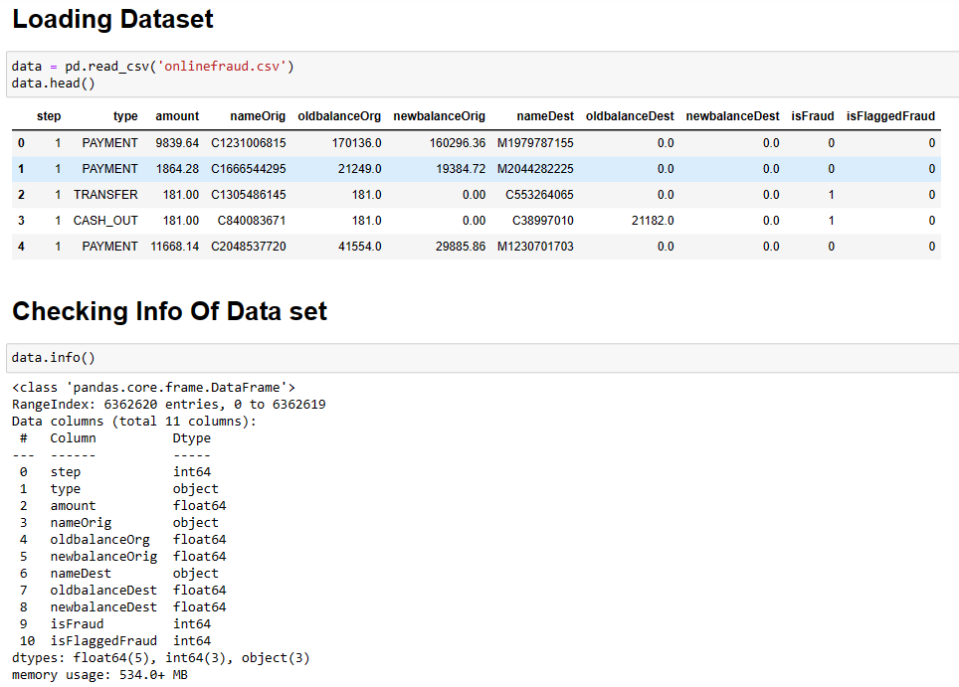
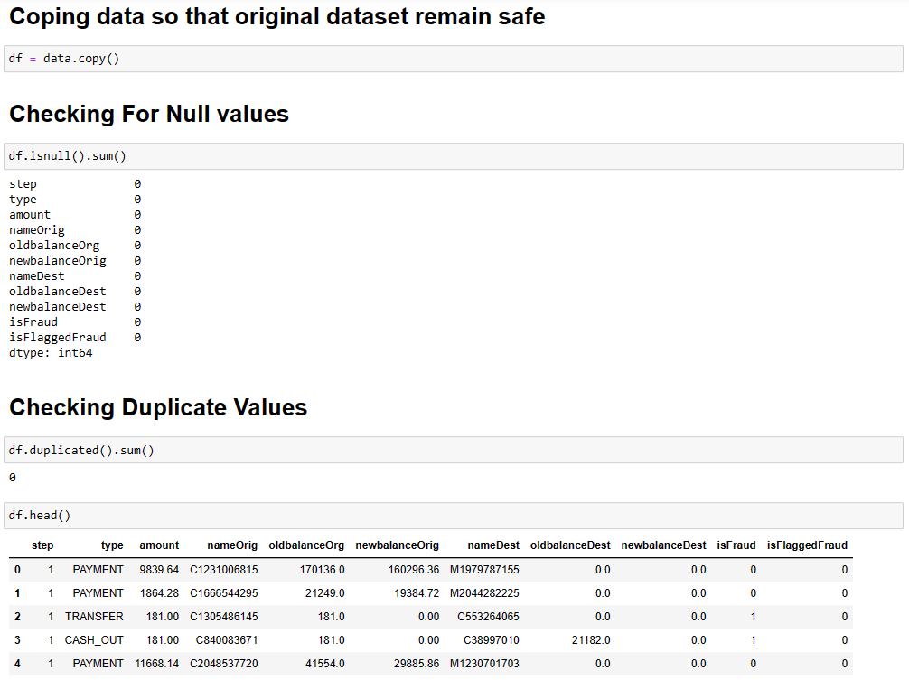
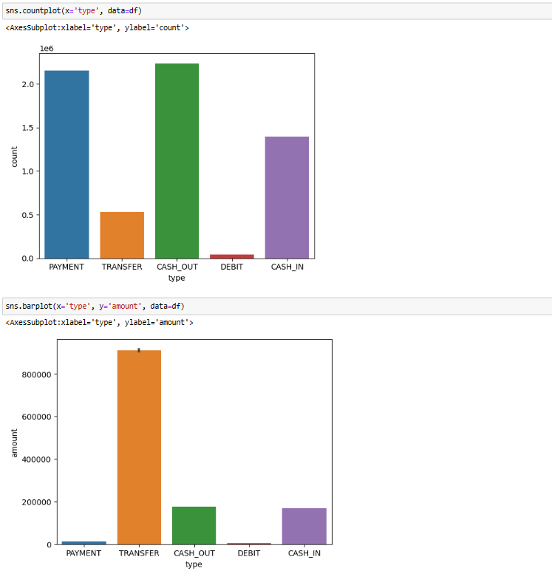
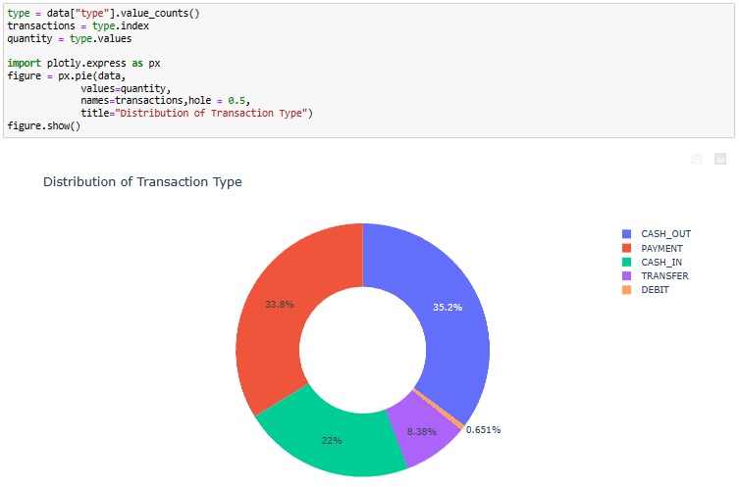
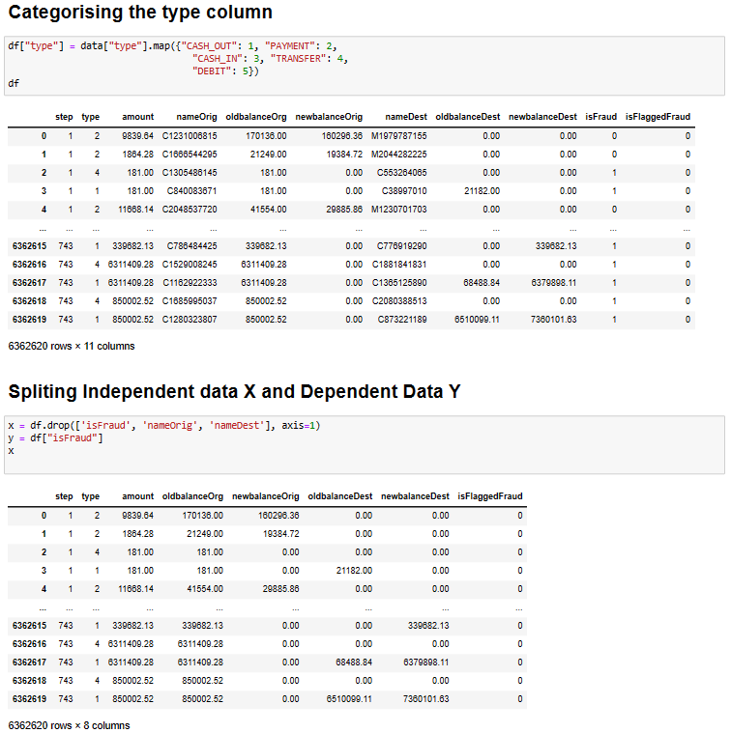
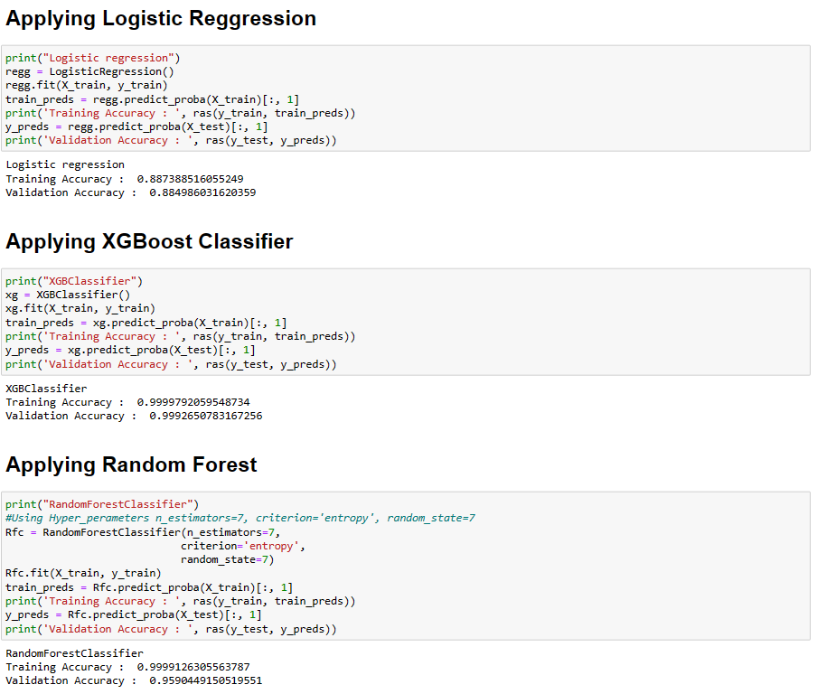






A
Visual Journey

Slide 16
Findings

Slide 17
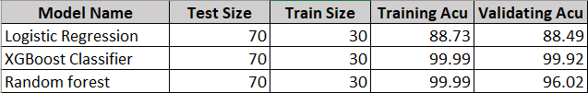
Findings
Thus, we can say that XGBoost Classifier was the best suited algorithm for our dataset.

Slide 18
Bibliography
https://www.geeksforgeeks.org/online-payment-fraud-detection-using-machine-learning-in-python/
https://stripe.com/en-in/resources/more/how-machine-learning-works-for-payment-fraud-detection-and-prevention
https://ieeexplore.ieee.org/document/10142404
https://iopscience.iop.org/article/10.1088/1742-6596/2023/1/012054
https://www.kaggle.com/datasets/rupakroy/online-payments-fraud-detection-dataset

